Slide 1
Distributed Stream Processing with Apache Spark
Pravin Y Pawar

Slide 2
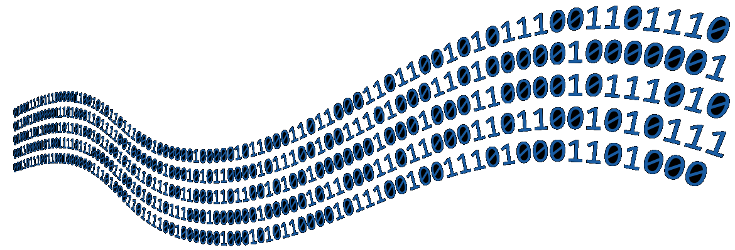
Stream Processing
Unbounded data
The discipline and related set of techniques used to extract information from unbounded data
Unbounded data (as per Tyler Akidau)
A type of dataset that is infinite in size (at least theoretically)
Information systems are built on hardware with finite resources like memory and storage, they cannot hold unbounded datasets
Data is received at the processing system in form of flow of events over time - as streams of data
dzone

Slide 3
Stream Processing (2)
Factors
Processing
Concerned with processing of data as it arrives to the system
Stream processors runs constantly for as long as the stream is delivering the new data
Theoretically , forever
“Time”
Stream processing program assumes input is potentially infinite in size and observed over time
Data at rest is data from past – initially was stream of data collected over time into storage
Data in motion needs to take time difference into consideration
Event time and processing time
Becomes more important when need to correlate, order or aggregate event wrt another
Uncertainty
No assumptions are made on the throughput at which events are received
Needs to match up with sudden arrival of input with computing resources necessary to process
If not planned, might face delays, resource constriction, of failure
Dealing with this uncertainty in future in critical aspect of streaming processing

Slide 4
Distributed Stream Processing
Necessity
Distributed processing
Batch processing has access to complete dataset , with streams only small portion of dataset is available at any time
Becomes more aggravated in distributed system, input stream is further divided into partitions and resides on different nodes in system
Needs to provide an abstraction that hides complexity from user!
Stateful Stream Processing
Poses additional burdens on the distributed stream processing system
Need to ensure that
state is preserved over the time
data consistency guarantees, even in case of partial system failures

Slide 5
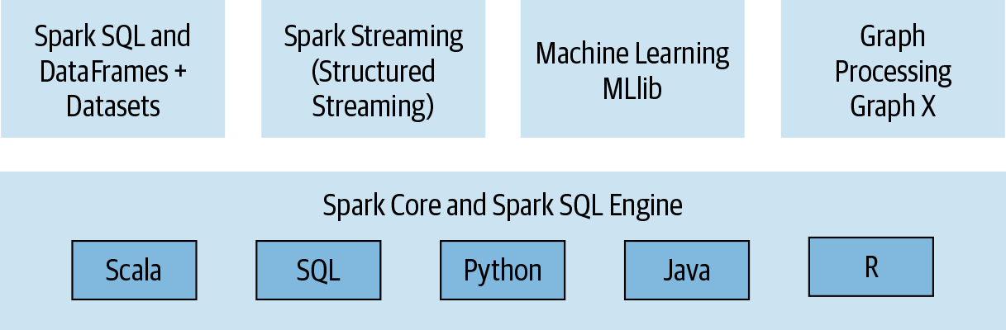
Apache Spark as a Solution
A unified engine for data processing
Fast, reliable and fault-tolerant distributed computing framework for large scale data processing
A unified analytics engine offering both batch and streaming capabilities
Developers needs to learn only one new paradigm for both ways of data processing
With compatible polyglot APIs approach in Scala, Java, Python and R
oreilly

Slide 6
Evolution of Spark
Two waves
First Wave : Functional APIs
Early days, known for novel use of memory and functional APIs
Use of in-memory model for data processing resulted into faster data processing
Core abstraction Resilient Distributed Dataset (RDD) brought a rich functional programming model abscising the complexities of distributed data processing
Transformations and actions
Second Wave : SQL
Second game changer was introduction of Spark SQL , DataFrames ( and Datasets) APIs
Adds SQL support to any dataset that has schema
Possible to query CSV, Parquet or JSON dataset similar to a SQL database
Lowered barriers for adaption – data scientists, business analysts can use it easily

Slide 7
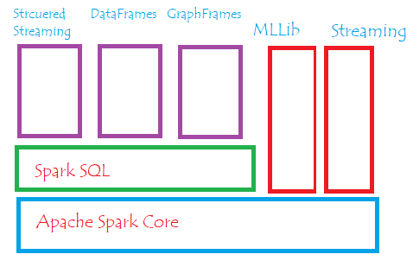
Spark Components
Consists of
core engine
a set of abstractions built on top of it (horizontally)
libraries that use abstractions to address a domain (vertically)

Slide 8
Tale of Two APIs
Spark Streaming and Structured Streaming
Spark Streaming
First streaming engine based on distributed capabilities of Spark
Spark 0.7.0 release in Feb 2013
Based on simple but powerful premise
Apply Sparks distributed computing capabilities to stream processing by transforming continuous streams of data into discrete data collections
Micro batching!
Uses same functional programming paradigm as Spark core but introduces a new abstraction
Discretized streams – exposes a programming model to operate on data in stream
Structured Streaming
Stream processor built on top of Spark SQL abstractions
Extends Dataset and DataFrame APIs with streaming capabilities
Adopts schema oriented transformation model – structured part in name
Inherits optimizations implemented in Spark SQL
Introduced in 2017 with Spark 2.2 release
Still evolving fast with each new version of Spark!

Slide 9
Thank You!
Reference
Stream Processing with Apache Spark
Mastering Structured Streaming and Spark Streaming
By Gerard Maas and Francois Garillot
In our next session:

